Slide 1
24. Import External Java Libraries via Gradle

Slide 2
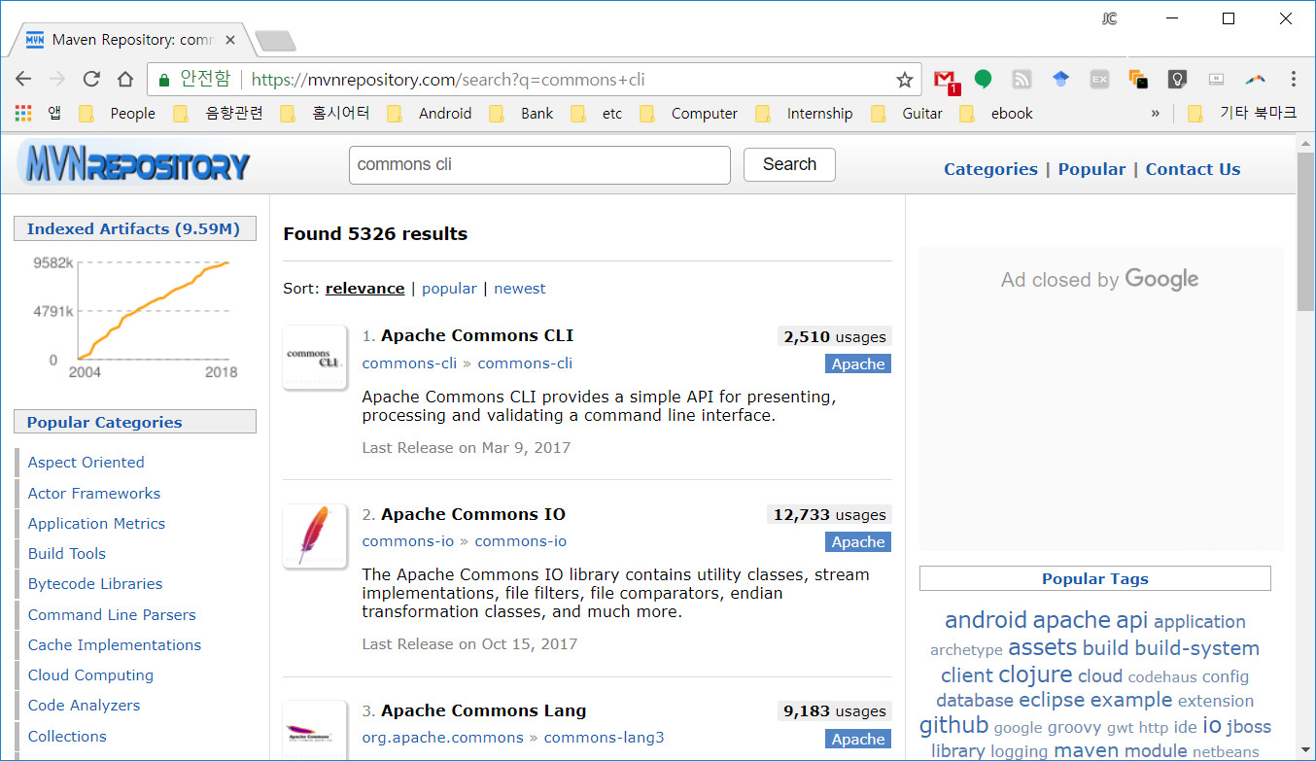
Find external libraries from the maven repository
(1) Type search keyword for a external package and click the 'Search' button.
(2) Click the name of the library.

Slide 3
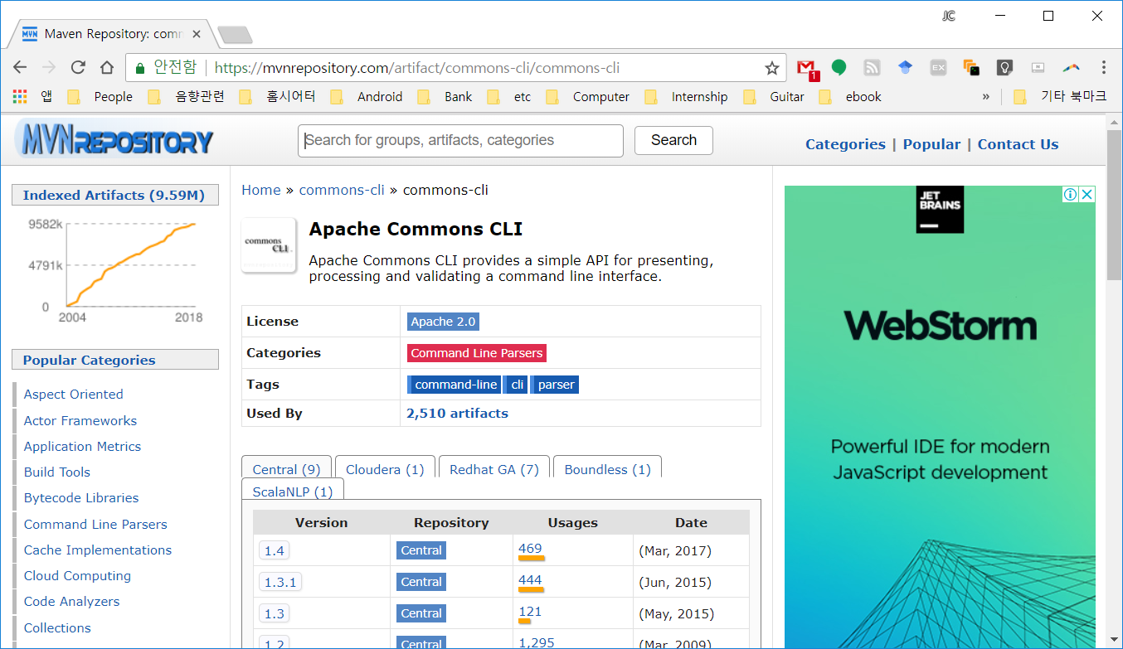
Click the version you want to import

Slide 4
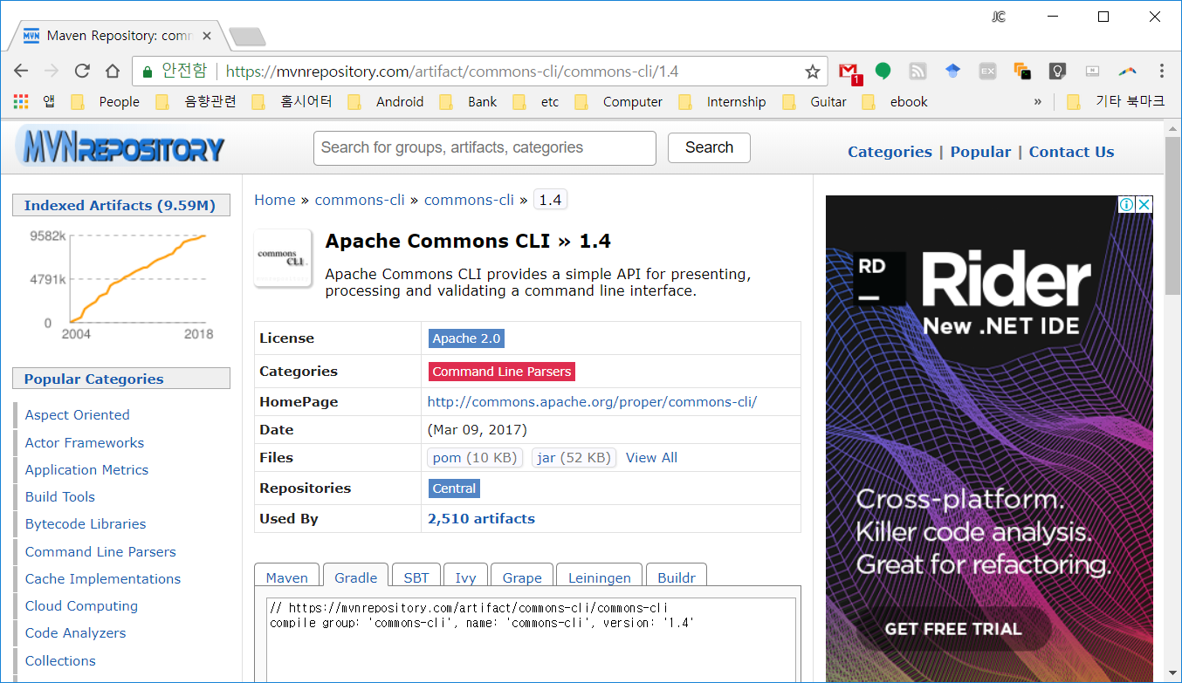
Choose Gradle tab and copy the code

Slide 5
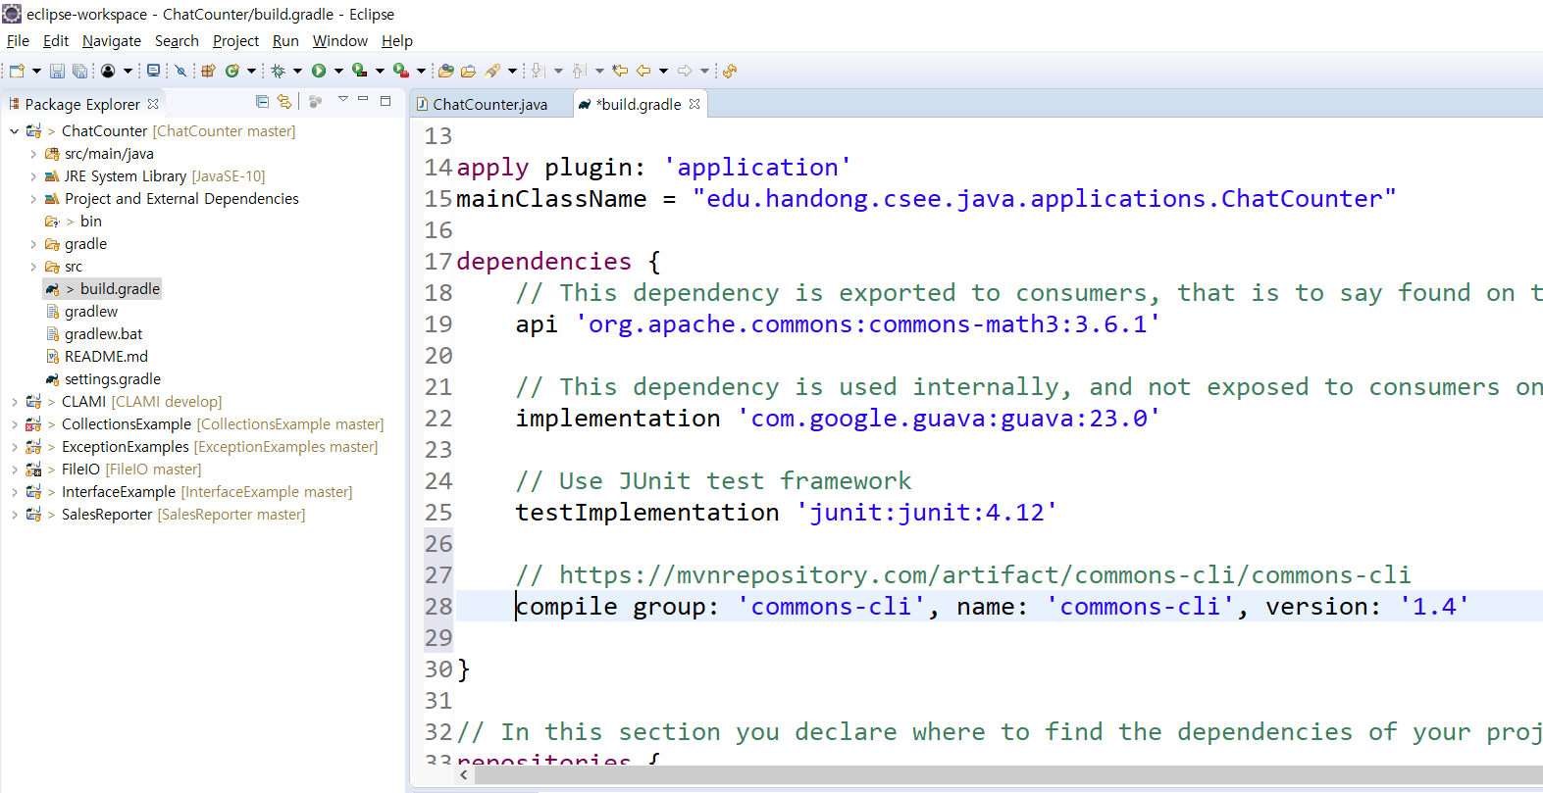
Put the code in build.gradle in Eclipse
(2) Find dependencies section.
(1) Open build.gradle.
(3) Put the copied code in the dependencies section.

Slide 6
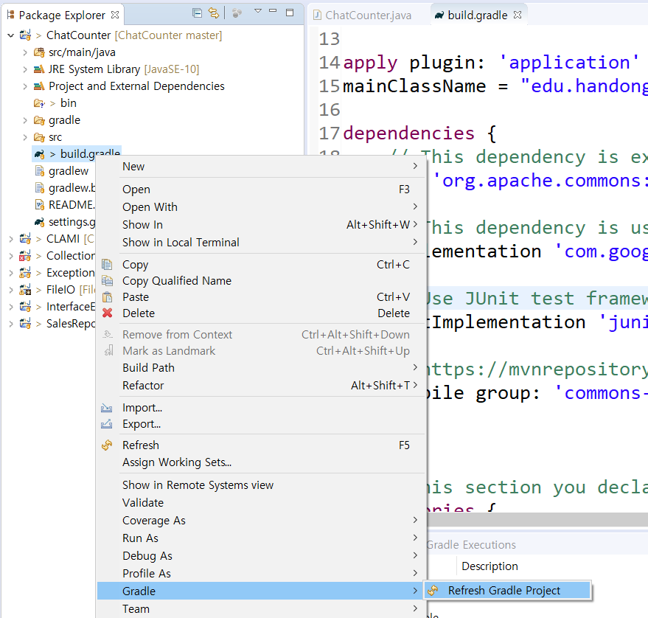
Refresh your project in Eclipse
This will automatically download the external package from the maven repository and import it to your project.

Slide 7
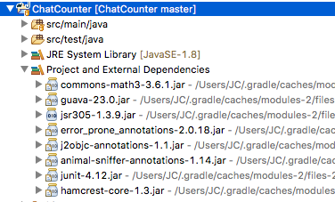
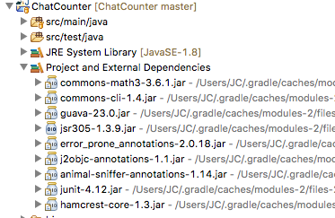
Apache commons CLI package is successfully added!

Slide 8
Tips for HW3
You may use OpenCSV to read csv files.
http://opencsv.sourceforge.net/

